Slide 1
FARM TO STORE
A SMART APP CONNECTING FARM LAND TO MARKET STORE
BY
KALEESWARAN V
MOHIT P
3RD IT A

Slide 2
PROBLEM STATEMENT
Farm lands are going down at a good rate and it is something not to be proud of,
This is happening because of farmers not getting enough funding or not able to sell their goods at the right time.
What we hear is that the government is doing great help to farmers. So where
does all this help go ? Or why is the help not reaching on time ?
Government is a pretty big organisation and no one man handles it but on the farm land there is
only one farmer so what is the main issue here ? It is the Middleman who are representing the
organisation. So what do we do about it ?

Slide 3
ABSTRACT
We are proposing an android application which runs in local language which
connects farmers to government directly and by which the government can take a good control
over the crops and at what price they are sold so that they the farmlands are motivated and we
also bring in study material for farming so that we can provide digital farm learning which
promotes many upcoming individuals to take up farming as an hobby. We also bring in a
module which can show stock prices related to goods they wish to see and can help them invest
for the same. The authentication we use is the farmer id which is provided by government to the farmers

Slide 4
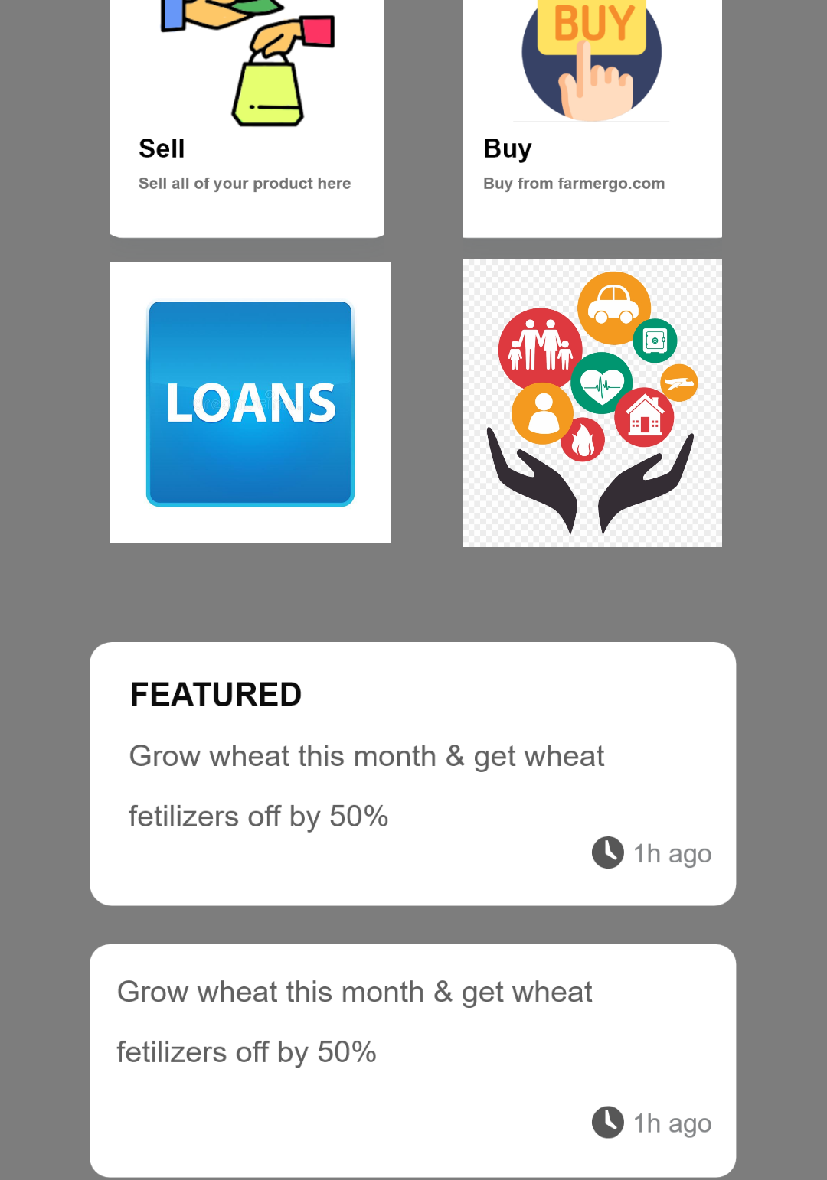
BENEFITS
Direct Connection to government
Digital learning
Investment
Bank loans are made automated.
Pay back are also automated.
Free Application

Slide 5
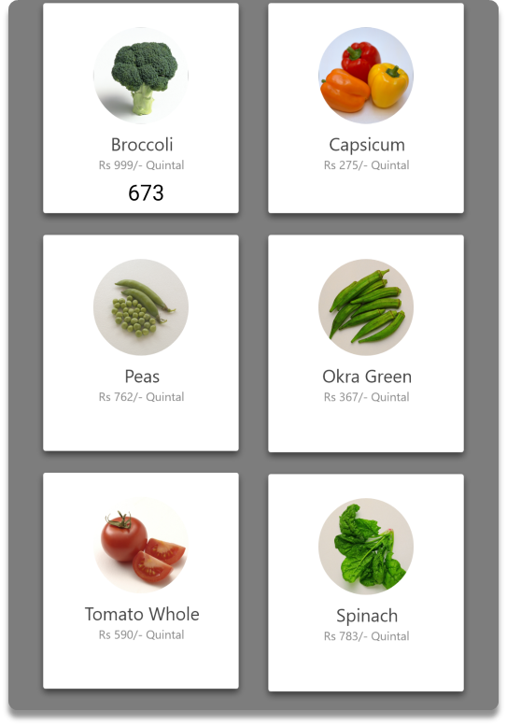
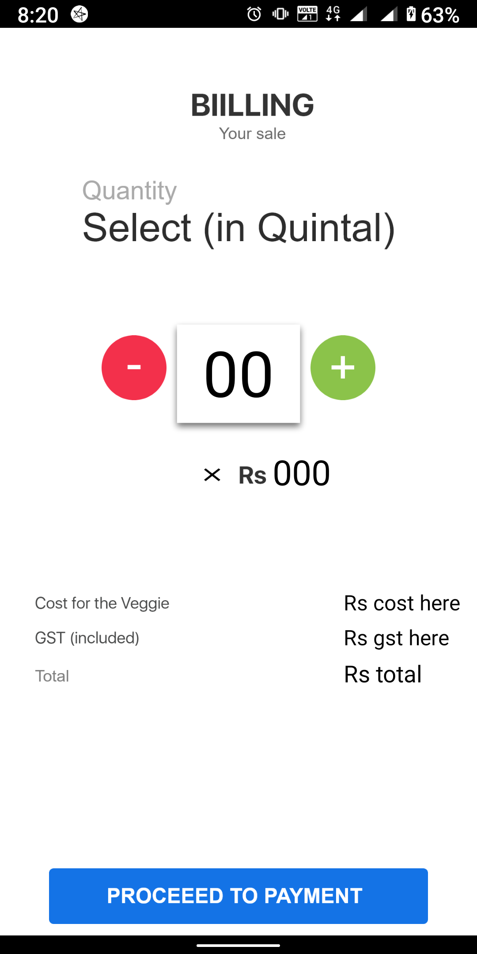
NOVELTY
The existing app only provides details and rates of goods but we bring a system in
which you can schedule the pick up time of crops. This app brings a digital learning module and
insurance module where they can insure their crops.

Slide 6
THANK YOU

